Slide 1

DEPARTMENT OF ARTIFICIAL INTELLIGENCE AND DATA SCIENCE ACADEMIC YEAR 2025 - 2026 SEMESTER III ARTIFICIAL INTELLIGENCE LABORATORY MINI PROJECT REVIEW <TITLE OF THE PROJECT>
REGISTER NUMBER | 2117240070049
NAME | DEEPAK G
YEAR | II
SECTION | A
FACULTY IN-CHARGE | Mrs. M. Divya

Slide 2
PROBLEM STATEMENT
Sudoku is a logic-based number-placement puzzle where the goal is to fill a 9×9 grid so that each row, column, and 3×3 subgrid contains digits 1–9.
Manual solving can be time-consuming and error-prone.
The aim is to build an interactive Sudoku solver that can both allow user input and solve the puzzle automatically using the Backtracking algorithm.
This project demonstrates the application of AI search techniques and constraint satisfaction in solving combinatorial problems.
Expected Result: A functional Sudoku solver that provides real-time solving visualization and user interactivity.

Slide 3
THEORETICAL BACKGROUND
Artificial Intelligence Context: Sudoku solving is modeled as a Constraint Satisfaction Problem (CSP) in AI.
Algorithm Used: Backtracking Algorithm, a depth-first search (DFS) method for finding solutions by exploring possible combinations recursively.
Why Backtracking?
Simple and effective for constraint-based puzzles.
Ensures completeness — finds a solution if one exists.
Can be combined with heuristics like “most constrained variable” for optimization.
Working Principle:
Choose an empty cell.
Attempt to assign a valid number (1–9).
Recursively solve the rest of the board.
If no valid number fits, backtrack and try another possibility.
Example:
Suppose cell (0,0) has no conflicts for numbers 1–9.
Assign 5 → move forward → if no future solution → revert to (0,0) and try next value

Slide 4
IMPLEMENTATION AND CODE
Link to code in Git-hub Repository
List | Git-hub Repository Links
Implementation of Code Link | https://github.com/DeepakG77/AI-MINI-PROJECT.git
Word Document Report Link | https://1drv.ms/w/c/2998d084b8152fa5/ET70fLNjfYBLuoOyJOX61IgBjx0Ei6OB1W0Z7dtvXefixQ
PPT Link

Slide 5
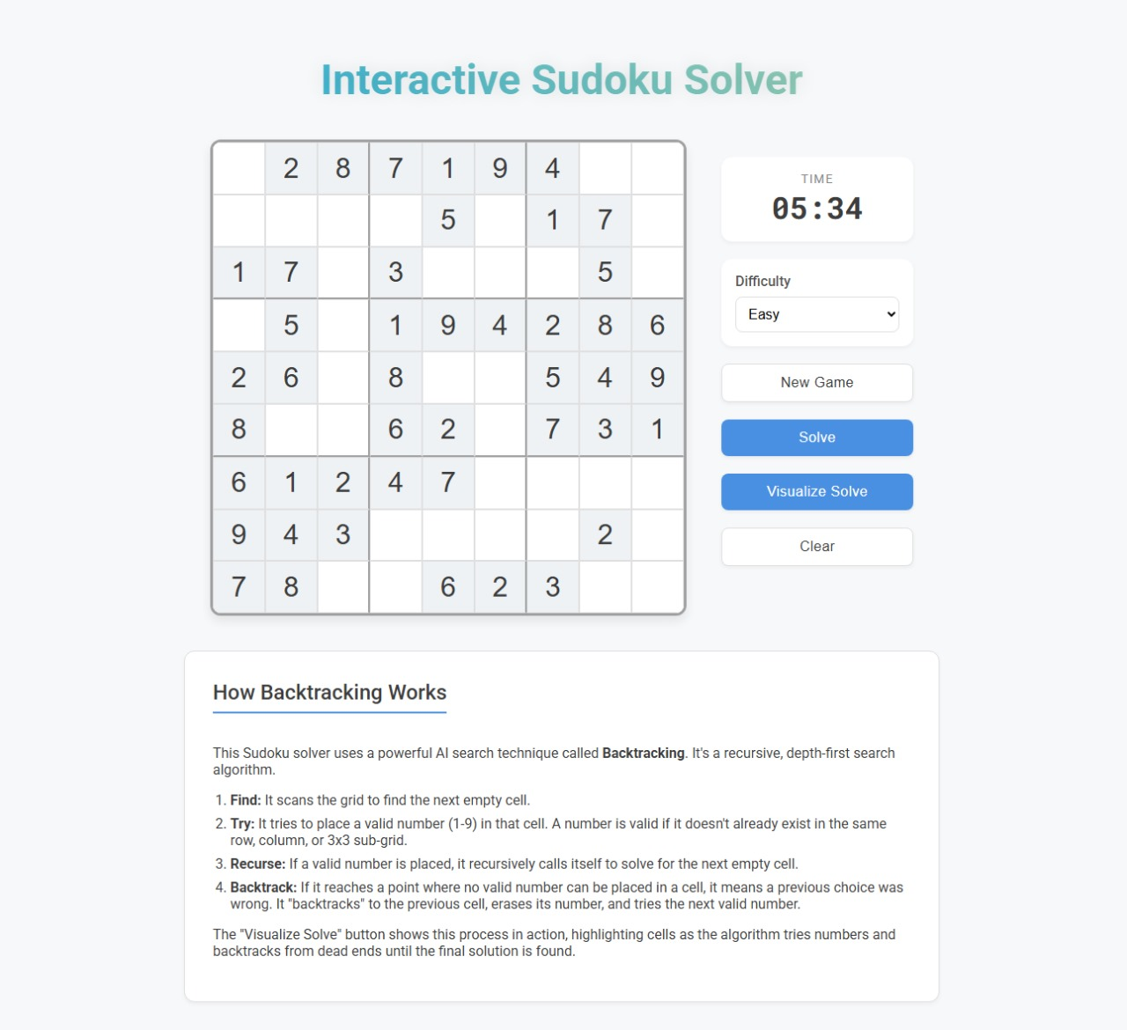
OUTPUT AND RESULTS

Slide 6
OUTPUT AND RESULTS
The system provides an interactive Sudoku grid using Tkinter, where users can input puzzles or use predefined ones.
On clicking “Solve”, the Backtracking algorithm fills the grid step by step, showing the solving process visually.
The solver handles both solvable and unsolvable puzzles efficiently and displays the final result clearly.
Performance: Solves standard puzzles within a few seconds.
Features:
Simple and user-friendly interface.
Real-time visualization of solving steps.
Option to reset and try new puzzles.
Future Enhancements:
Add hint system and difficulty levels.
Improve speed using heuristic optimization.

Slide 7
REFERENCES
Russell, S., & Norvig, P. — Artificial Intelligence: A Modern Approach, Pearson. https://aima.cs.berkeley.edu/
GeeksforGeeks — “Sudoku Solver using Backtracking in Python.” https://www.geeksforgeeks.org/sudoku-backtracking-7/
Towards Data Science — “How Backtracking Solves Sudoku Puzzles.” https://towardsdatascience.com/solving-sudoku-with-backtracking-1e9f7ae70b65
Programiz — “Backtracking Algorithm Explained.” https://www.programiz.com/dsa/backtracking-algorithm
Medium — “Building an Interactive Sudoku Game using Tkinter.” https://medium.com/@pythonmembersclub/building-an-interactive-sudoku-game-with-python-and-tkinter-7b7a9dbd1d46

